Slide 1
Snapshots from ecohydrology and ecosystem modeling at Luke
Samuli Launiainen
Team: J-P Nousu, Kersti Leppä, Olli-Pekka Tikkasalo, Toprak Aslan, Pavel Alekseychik, Leena Stenberg, Aura Salmivaara, Katja Rinne-Garmston et co.

Slide 2

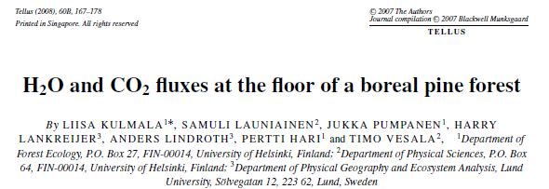
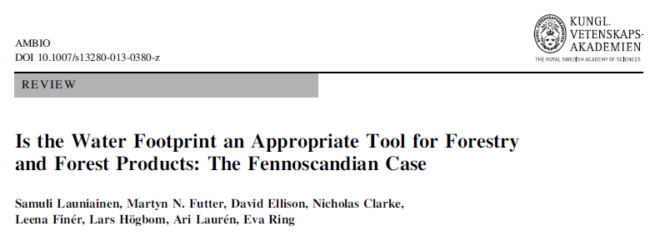
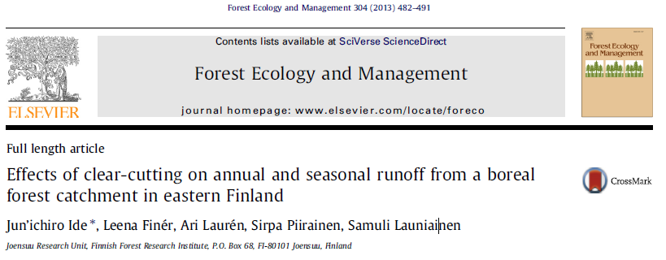
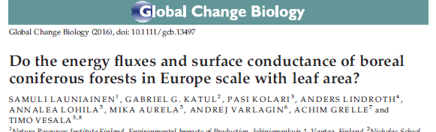
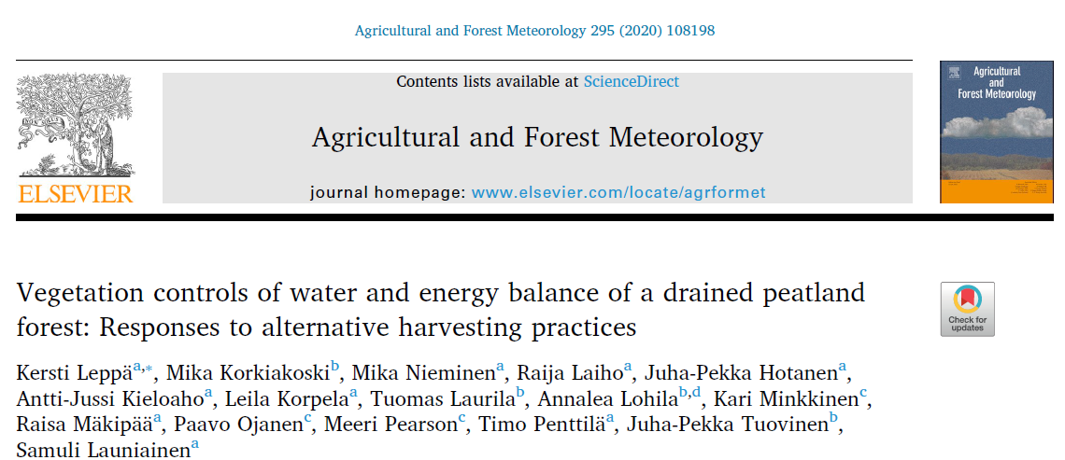
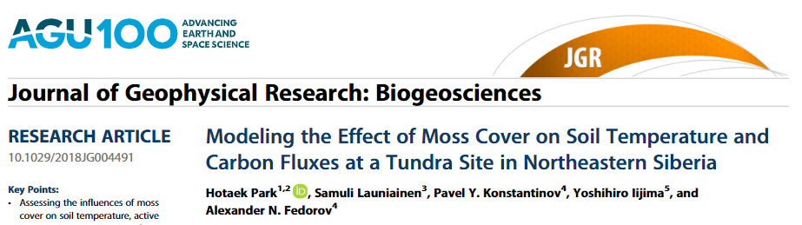
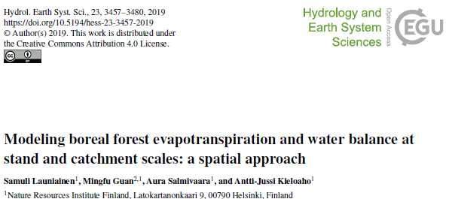
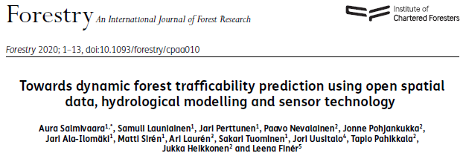
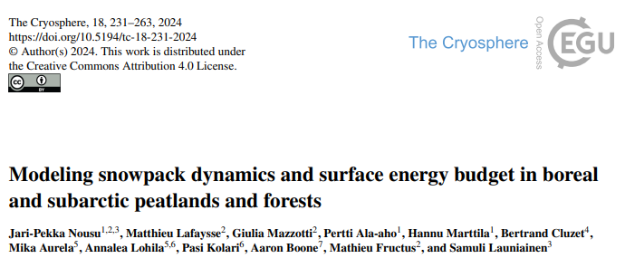
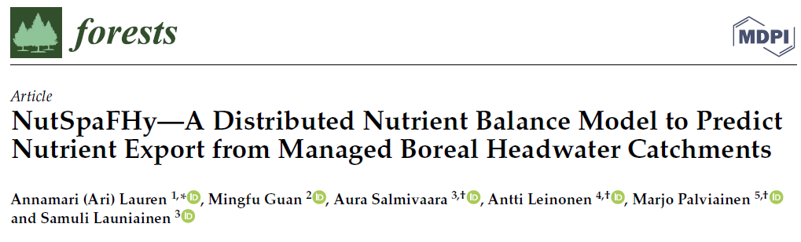
Who?
PhD meteorology (UH, 2004-2010)
Forest-atm interactions, EC, turbulence, canopy models
Senior Researcher (Metla, 2010-2015)
Forest hydrologist, environmental impacts
Academy Res. Fellow (Luke, 2016-2021)
Moss layer into ecosystem models
Principal Researcher (Luke 2021-)
Ecohydrology in a broad sense
Ecohydrologist & ecosystem modeler

Slide 3
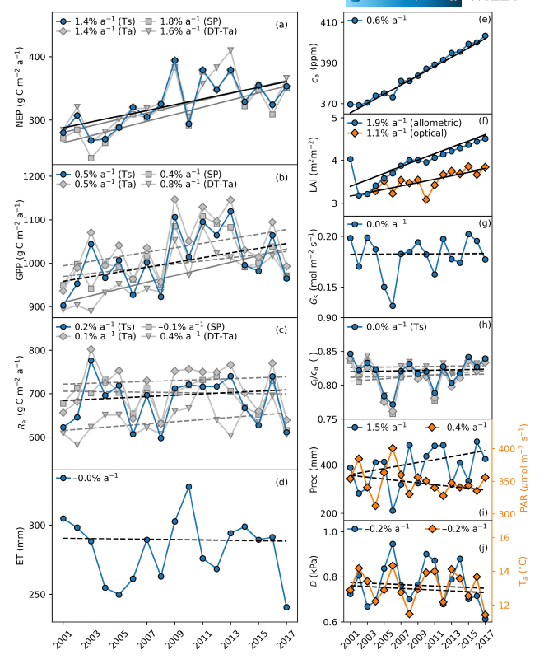
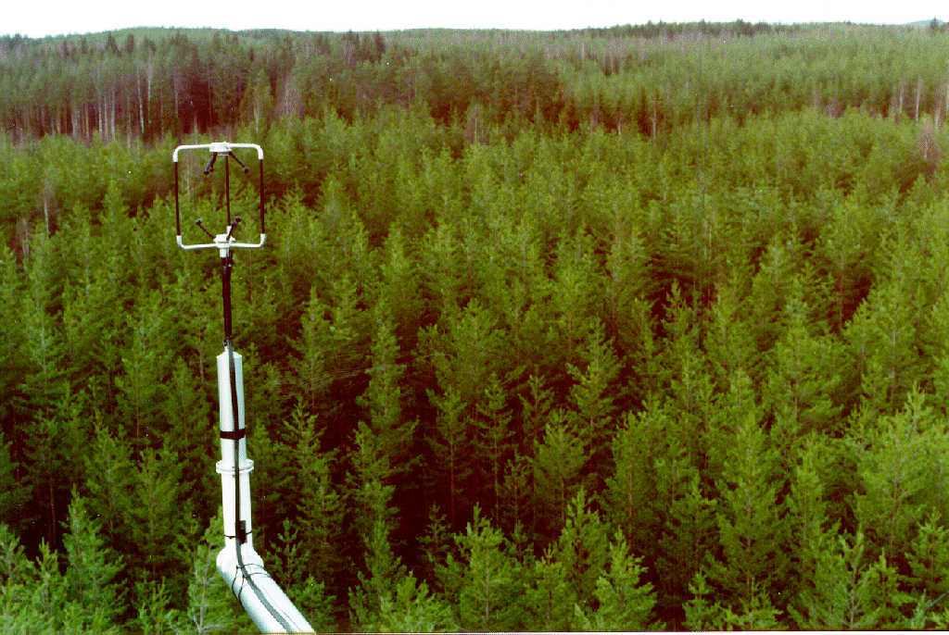
Why C sink increases at Hyytiälä?
NEP = - NEE increasing (+1.4 – 1.8% a-1)
Due to increasing GPP (+0.4 – 0.8 % a-1)
GPP trend resembles that of CO2
No statistically significant change in Re
No change in ET
Statistically insignificant increase in WUE & LUE

Slide 4
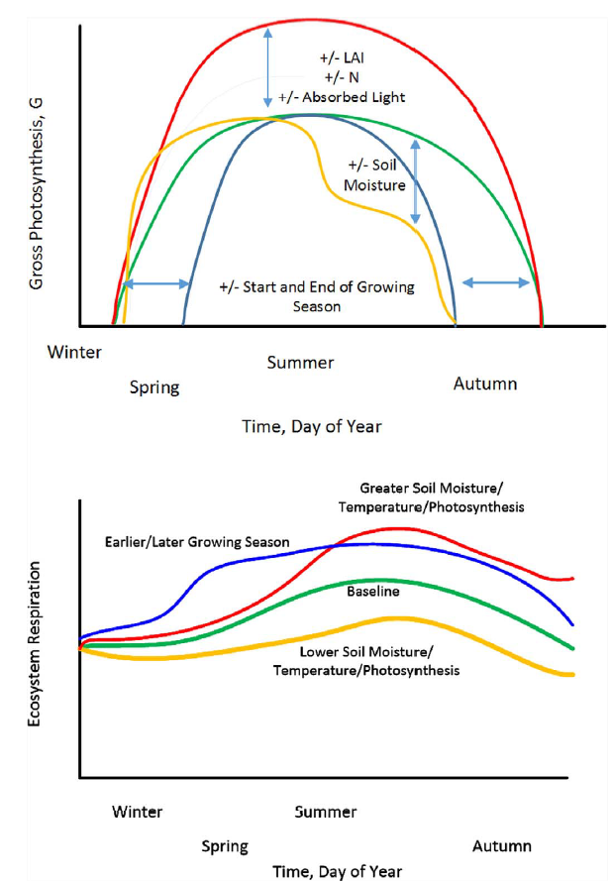
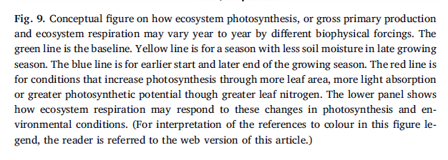
Multiple factors can explain increasing GPP
GPP = f(light, CO2, T, water availability, amount of biomass, …)
Atmospheric CO2 increase (+0.8 %a-1)
More food available
Longer growing seasons (yes, spring advance, p>0.05)
More time for breakfast and supper
Increasing diffuse radiation (yes, p>0.1)
Leaves deeper can eat more
Increasing leaf nitrogen content (yes)
hungrier leaves
Increasing biomass and LAI (+1.1 – 1.9 %a-1)
More leaves at the dinner table
Changing footprint (inevitably)
The part of forest seen by EC gets smaller as trees get taller
Baldocchi et al. 2018. Agr. For. Met
All can occur simultaneously (and likely are)
Importance depends on timescale and env. conditions

Slide 5
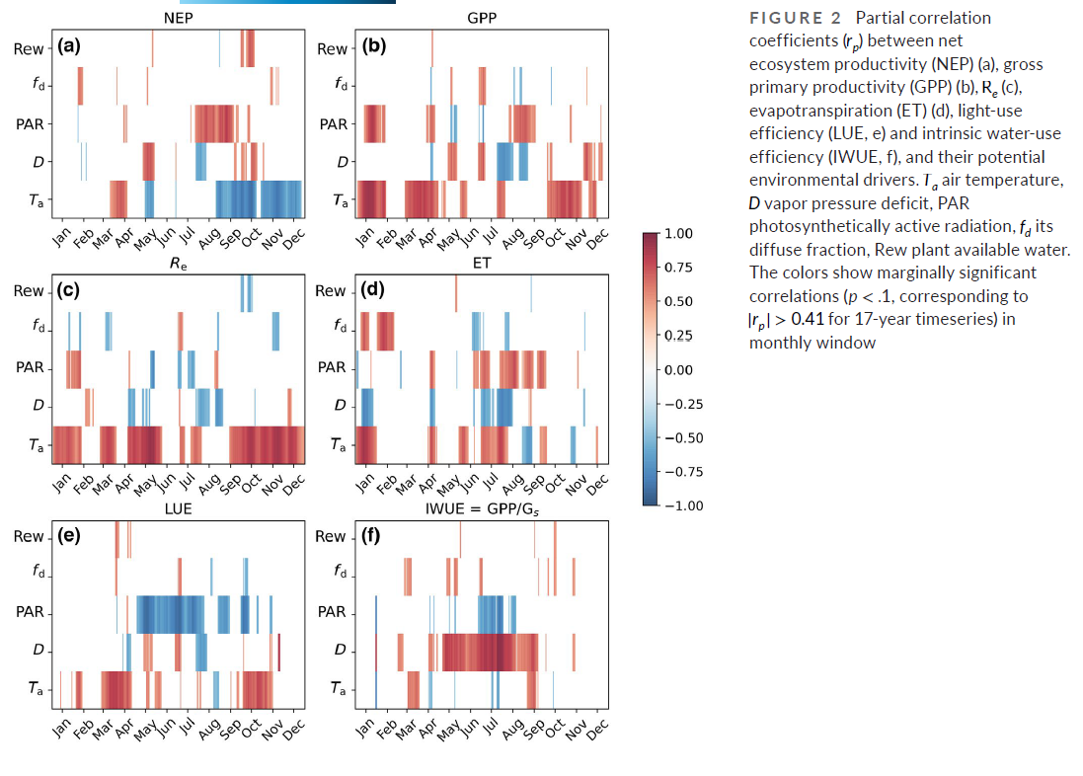
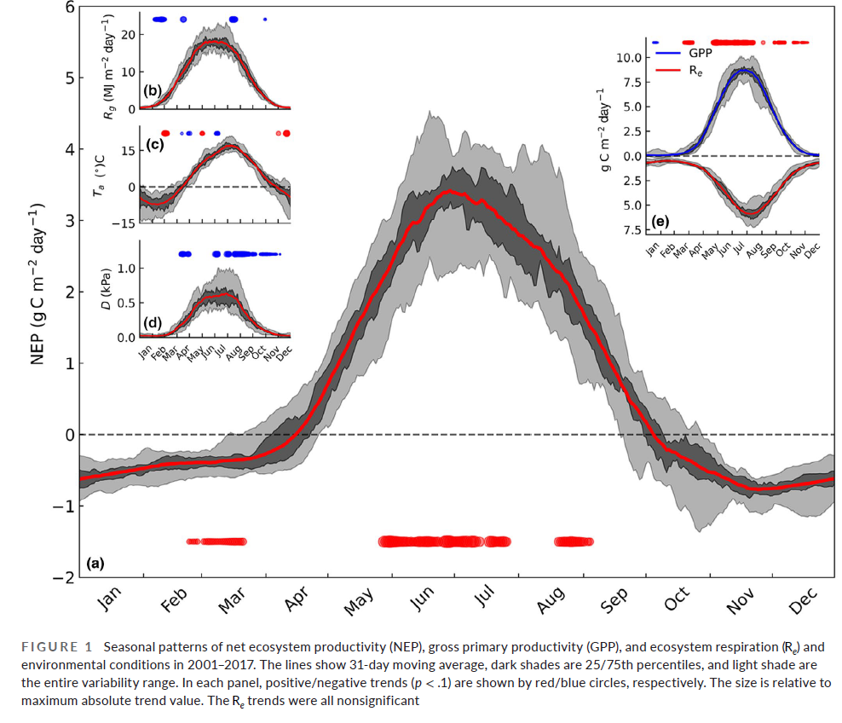
Trends – when?
Drivers?
Pearson correlation in
30-day moving window

Slide 6
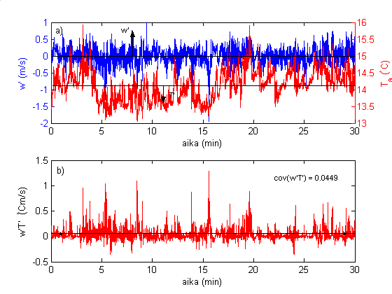
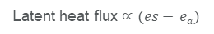
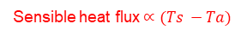
Environmental conditions
Ecosystem – atmosphere fluxes
Sensible heat flux$∝(Ts −Ta)$
Latent heat flux $∝(es− ea)$
source
CO₂ flux
sink
Day in July 2008
Day in July 2008
Short-term responses ’well’ understood. Effects of extreme conditions, acclimation and delayed impacts not

Slide 7
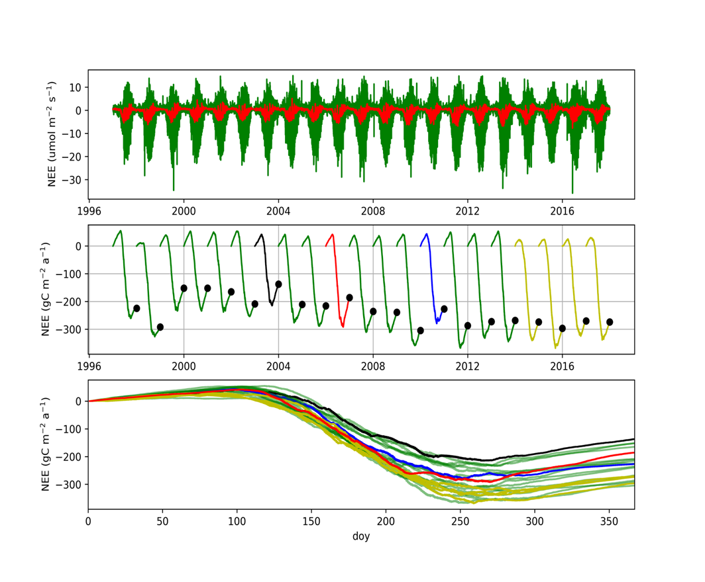
Annual carbon balance = time-integrated NEE
Numerous pathways to same annual balance
Processes non-linear
Strong seasonality
Compensatory periods
Trends are weak compared to uncertainty
Average environmental variables not relevant to explain or model inter-annual variability
Standard statistical methods not necessarily meaningful

Slide 8

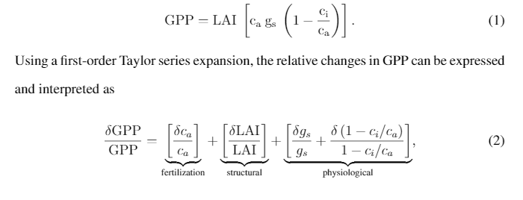
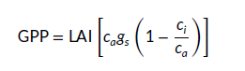
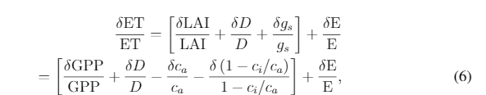
Ecosystem as a big leaf
How trends will change GPP & ET?
e_{a}
c_{a}
e_{s}
A_{n} = g_{s} (c_{a} –c_{i})
= c_{a} g_{s} (1-c_{i}/c_{a})
c_{i}
+
+
?
T_{r} = 1.6g_{s}[e_{a} – e_{s}(T_{l})]
+
+
-
?
?
light, T, VPD, water
plant traits
canopy structure

Slide 9
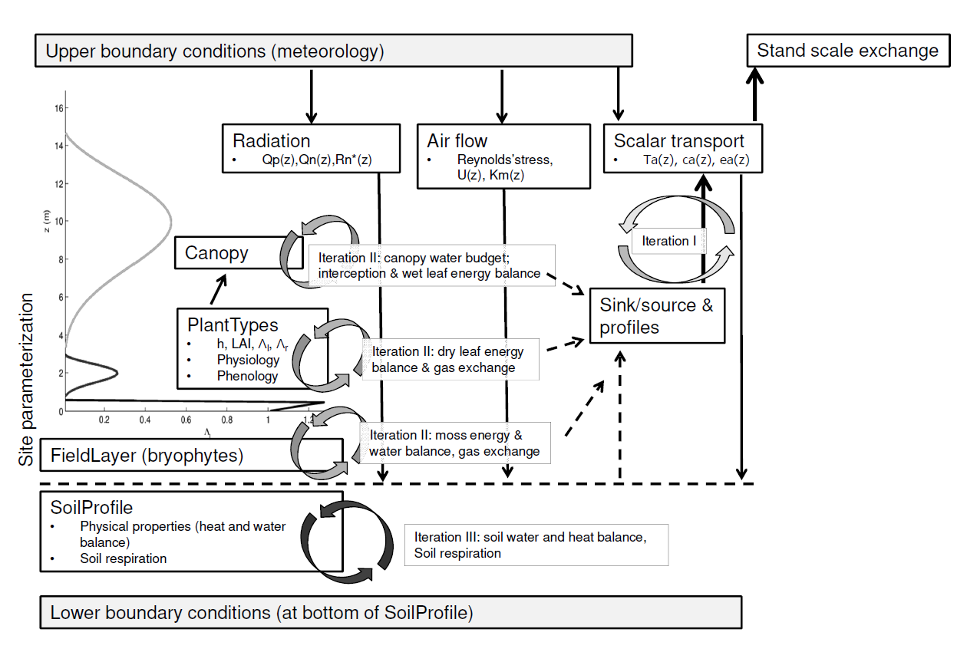
External forcings
pyAPES
Fluxes between system
and the environment
X(t₀) = [x₁(t₀)
x₂(t₀)
…
x_{n}(t₀)]
Processes ~ functions
System components = sub-models
Parameters ~ properties; depend on
current conditions and/or history
States ~ model state variables; depend on history
Y(t₀) = [y₁(t₀)
y₂(t₀)
…
y_{m}(t₀)]
GPP, ET & partitioning
LUE = GPP/Par
WUE = GPP/ET
IWUE = GPP / Gc
Launiainen et al. 2015. Ecol. Mod; 2016 Global Change Biol.
Leppä et al., 2020. Agric. For. Met

Slide 10
Model -scenarios
affect model parameters
External inputs X_{n} change
Numerical experiment, factorial design
LAI + CO2 + Nleaf + Met
LAI + CO2 + Met
LAI + Nleaf + Met
CO2 + Nleaf + Met
LAI + Met ← observed LAI trend
CO2 + Met ← observed CO2 trend
Nleaf + Met ← Vcmax, Jmax, etc. = f(Nleaf)
Met ← meteorological forcing (light, VPD, T, …). Constant CO2
Crank through number of runs
Analyze trends and compare to observed
Interpret findings

Slide 11
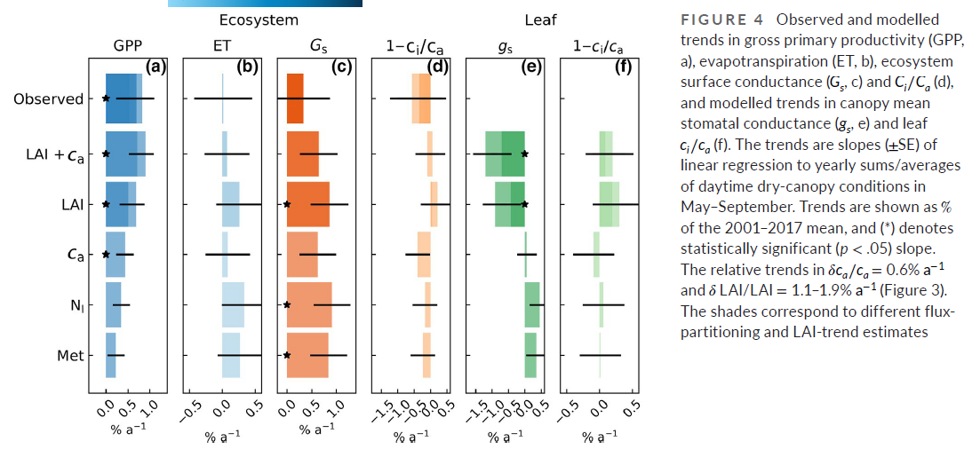
Met → inter-annual variability
Ca → 1/3 of observed trend
LAI → 2/3 of -”-
LAI + Ca → true trend + realistic change in WUE

Slide 12
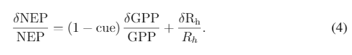
Interpreting the results using BL framework
+/-
+
-
-
-
+
+
+
-
+/-
Mean leaf-level gs decreases due to increase in LAI (light limitations) and ca, but does not change ci/ca.
Magnitude of physiological adjustments ~ effect of LAI → terms cancel each other
We get apparent dependency on CO2: dGPP/GPP ~= dCa/Ca

Slide 13
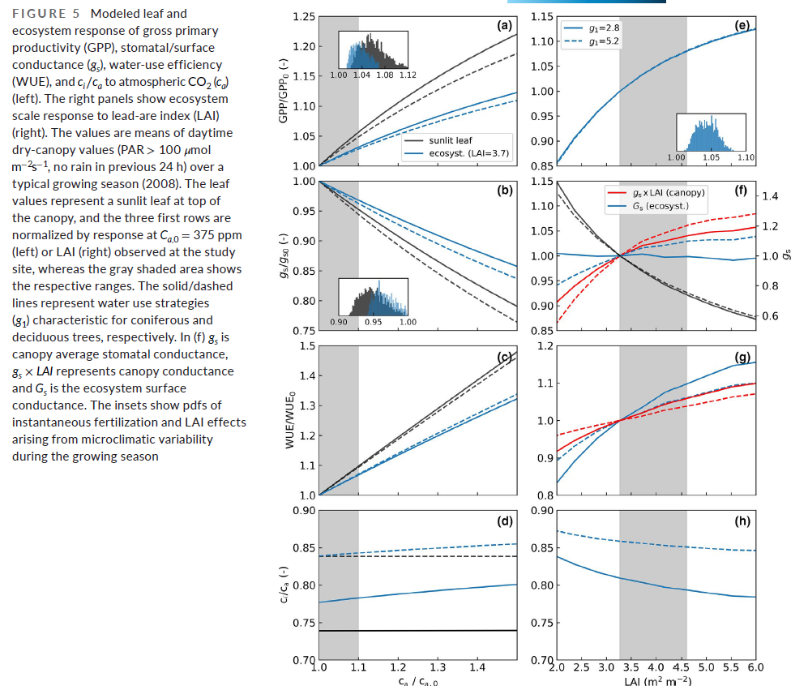
CO2 effect
Light limitations
Temperature limitations
’Liebig’s law’
Interplay between photosynthetic capacity & stomatal traits
Weaker at ecosystem level than at sunlit leaves
Weaker than thought in boreal forests?
CO2 →
LAI →

Slide 14
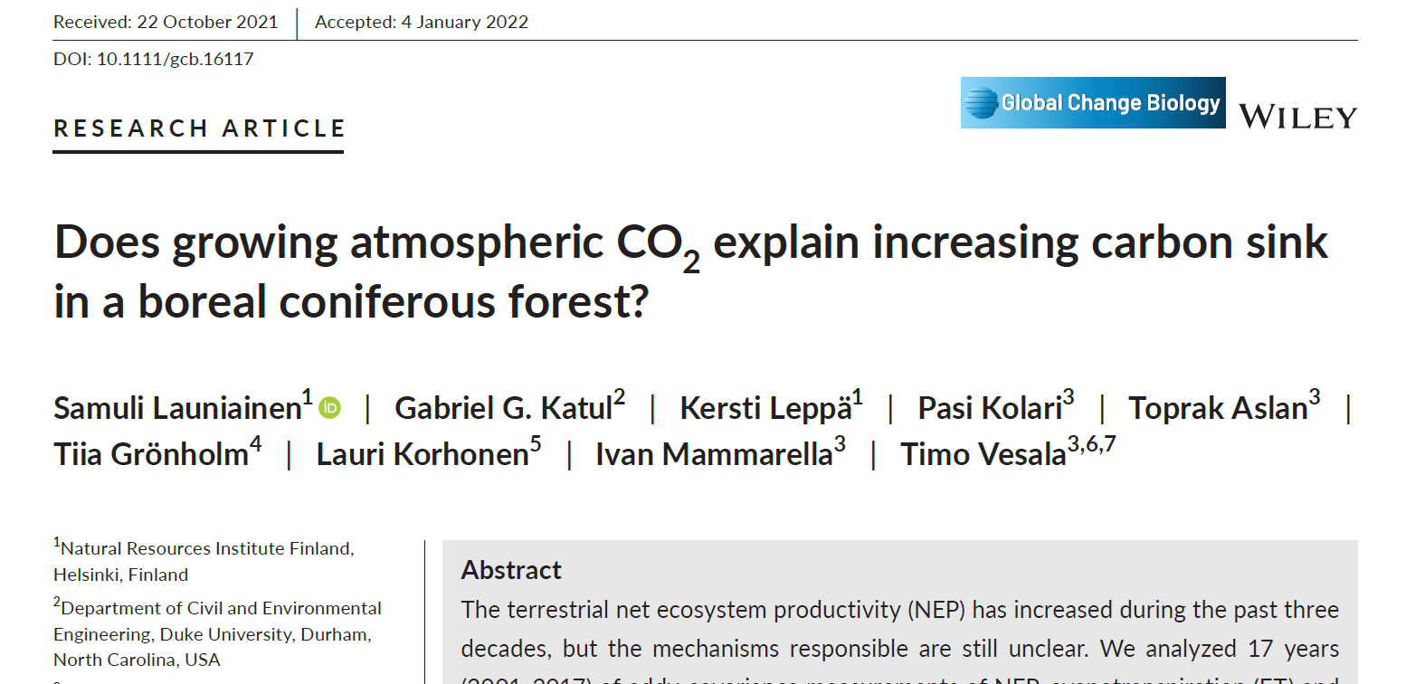
To conclude…
Increasing carbon sink mainly due to increasing GPP
LAI (stand growth!) was the main driver
CO2 fertilization explains ~1/3 of GPP trend. But explains improved water use efficiency
Respiration changes in line with GPP increase and litterfall (LAI) increase
NEP trend and trend in annual biomass growth ~comparable
Potential increase in leaf N has minor effect
No statistically significant changes in growing season length
Trends are weak compared to inter-annual variability & uncertainties
Long-term flux data is prone to errors
Stand dynamics and ’supplementary data’ not well enough measures
Compensatory mechanisms could be teased out only with a model!

Slide 15
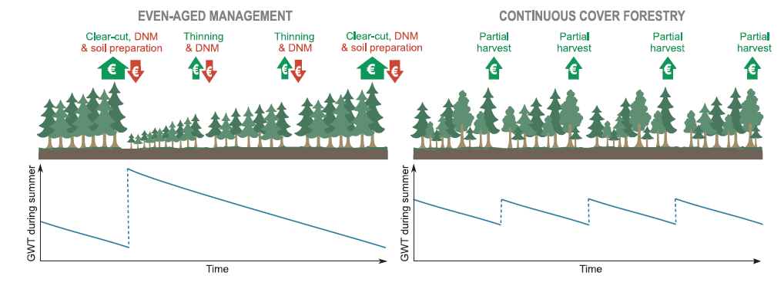
Peatland management ≈ water table management
4,7 Mha ditched from 1930’s to 1980’s. Spacing 20 – 60m, current depth 20 – 80cm
How WTL depends on stand attributes and peatland type across a climate gradient?
Growth = f(WTL)
GHG emissions = f(WTL)
Leaching = f(WTL)
Improved drainage by ditch maintenance: When needed & how deep is necessary?
Biological drainage == stand water use
How intense selection harvests or strip-cuttings
can be used?
Nieminen et al. 2018; https://doi.org/10.1016/j.foreco.2018.04.046

Slide 16

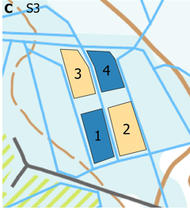

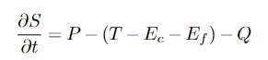
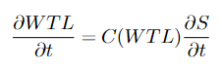
Modeling water table response
Kersti Leppä
Ecohydrological theory & literature
Process-model structure, functions, parameters
Inputs (open data + scenarios):
Forest attributes: LAI, height, tree type
Peat type: hydraulic properties
Ditch spacing & depth
Daily weather data
Outputs (daily):
WTL, soil moisture, snow, ET & components, runoff
KISS for practical use ☺
Precipitation (P)
Transpiration (T)
Interception (E_{c})
tree canopy
Evaporation (E_{f})
throughfall
moss
snow
infiltration
Drainage (Q)
L
Peat water storage (S)
L

Slide 17
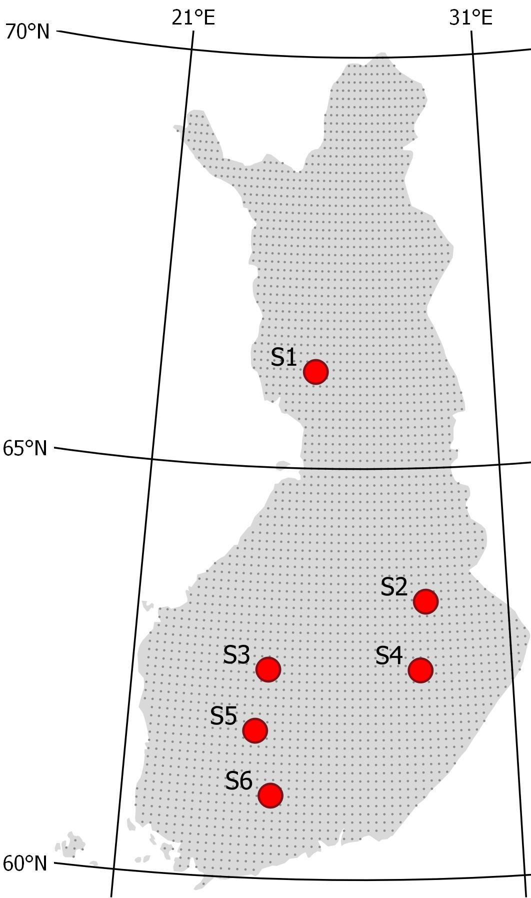
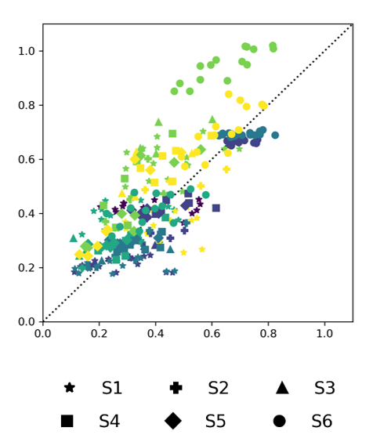
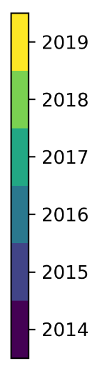
Benchmarking & factorial experiment
June-Oct mean WTL on the right ballpark
Next, factorial simulations:
Basal area (BA): 6 to 30 m²ha⁻¹, 5 levels
deciduous fraction: 0 & 0.5
ditch spacing: 25 & 75 m
ditch depth: 0.3 & 1.0 m
peat type: sphagnum/carex
climate: south/north
Total 180 combinations
WTL[m]
Modelled
Observed
Leppä, K. et a. 2020. Front. Earth Sci., 8: 576510. https://doi.org/10.3389/feart.2020.576510

Slide 18
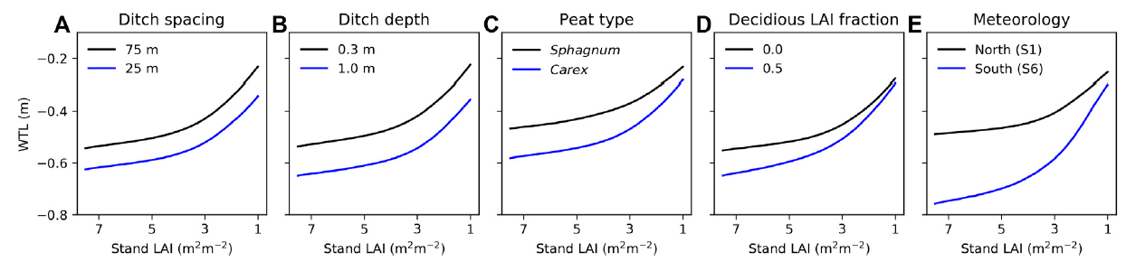
WTL vs. stand leaf-area
Deepens non-linearly with LAI,
increased interception & transpiration.
Mixed stands Understories
BA & Vol
Use cases
Productivity and GHG-balance tradeoff of alternative management (e.g. Eyvindson et al. 2023, https://doi.org/10.1139/cjfr-2022-0101, Lehtonen et al. 2023, preprint)
New guidelines for DNM: shallow ditches are often enough (Hökkä et al. 2022, https://doi.org/10.14214/sf.10494)
Inverse question: how ditch blocking and emerging vegetation affects WTL after restoration?

Slide 19
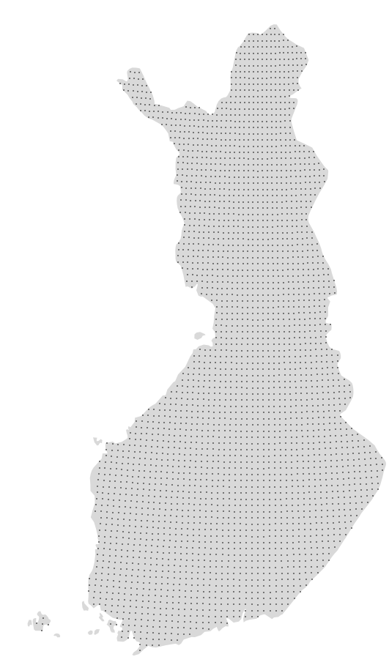
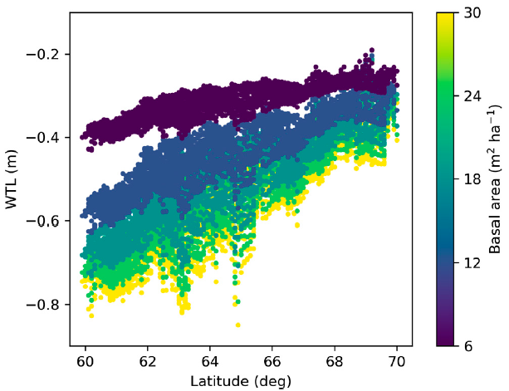
Simulations over climatic gradient in Finland
Biological drainage (ET) has great role in Southern Finland
Strong potential for using CCF, less need for DNM
Ditch drainage remains crucial in Northern Finland
Patterns will shift with climate change, due changing ET/P
Can WTL become too deep in the future?
ET
ET
ET / P

Slide 20
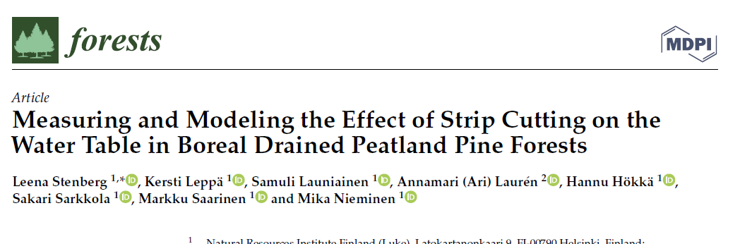
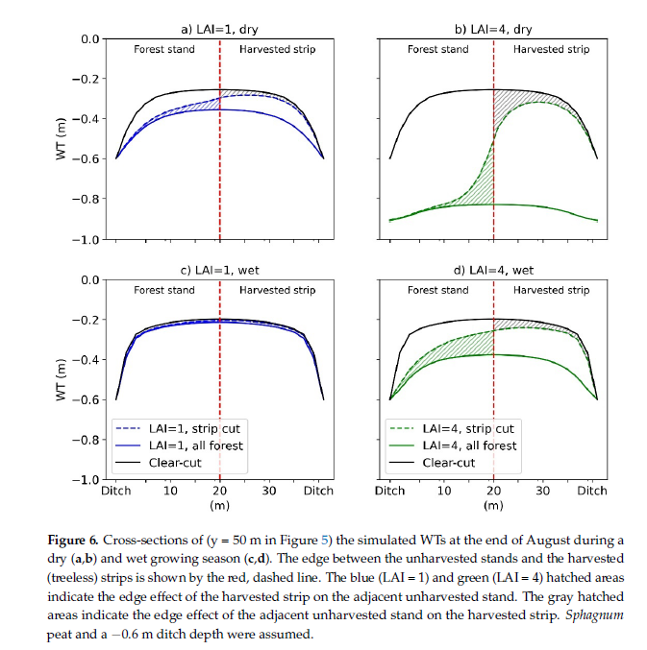
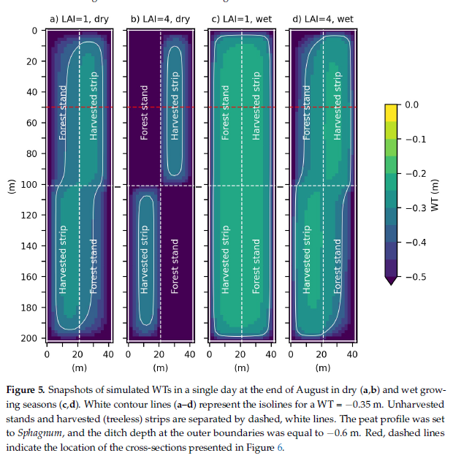
2D saturated zone Darcy flow with constant head ditch BC

Slide 21
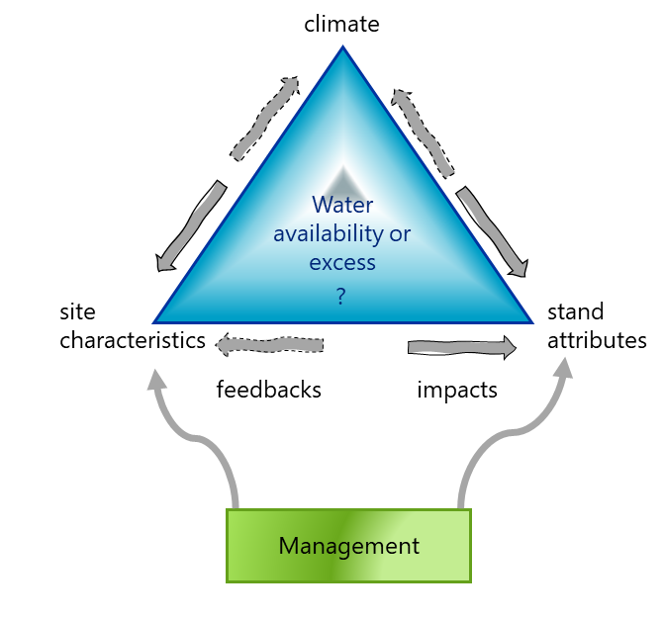
Spatial ecohydrology
Adaptation: need to integrate ecohydrology better into forest dynamics models
How water availability affects productivity & mortality?
How and where possible to adapt management?
Mitigation: ecohydrology into C-cycle models
Soil moisture and landscape heterogeneity as control of C balances
Upscaling from point to regional scale
Capability to predict soil moisture and water table dynamics:
Understanding & predicting forest disturbances
Fire risks, forest vehicle trafficability
Planning restoration
Merging GIS & ecosystem modeling

Slide 22
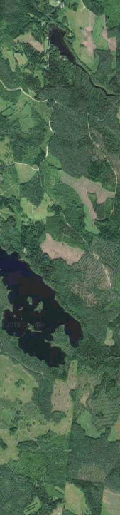
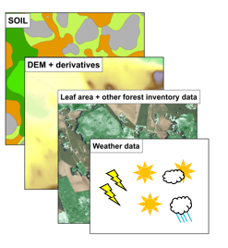
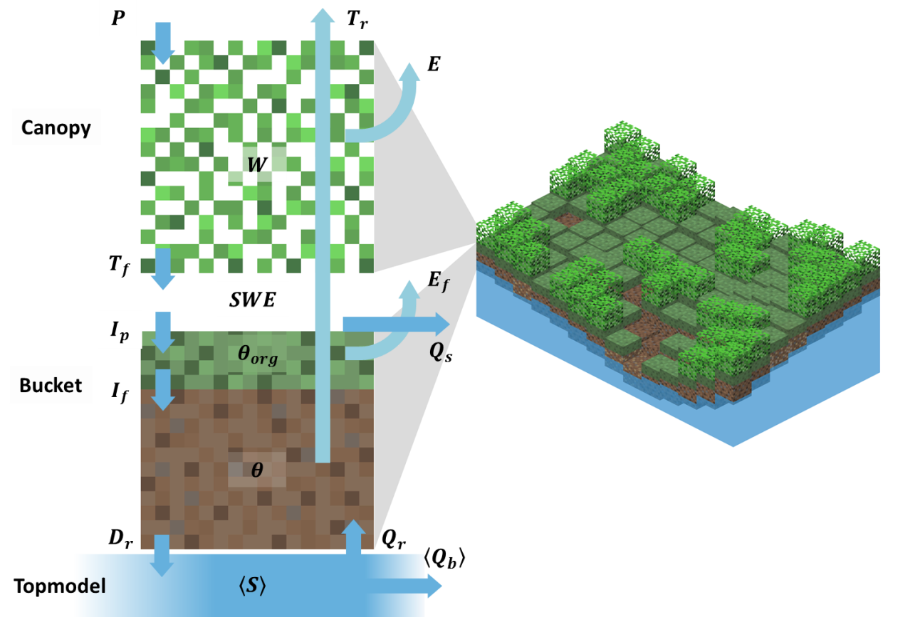
Landscape soil moisture
Soil strength: trafficability, harvest planning
Water availability: climate change adaptation
Excellent open data on
Stand attributes (mNFI,16x16m)
DEM, topographic wetness indices
Streams, water bodies, non-forest areas
Soil hydraulic properties?
We developed new PTF’s to predict soil porosity, field capacity & wilting point from available spatial data
Mineral forest soils: can be best estimated based on soil fertility type available in mNFI
Launiainen et al. 2019; https://doi.org/10.5194/hess-23-3457-2019
Launiainen et al. 2022, https://doi.org/10.3390/f13111797

Slide 23


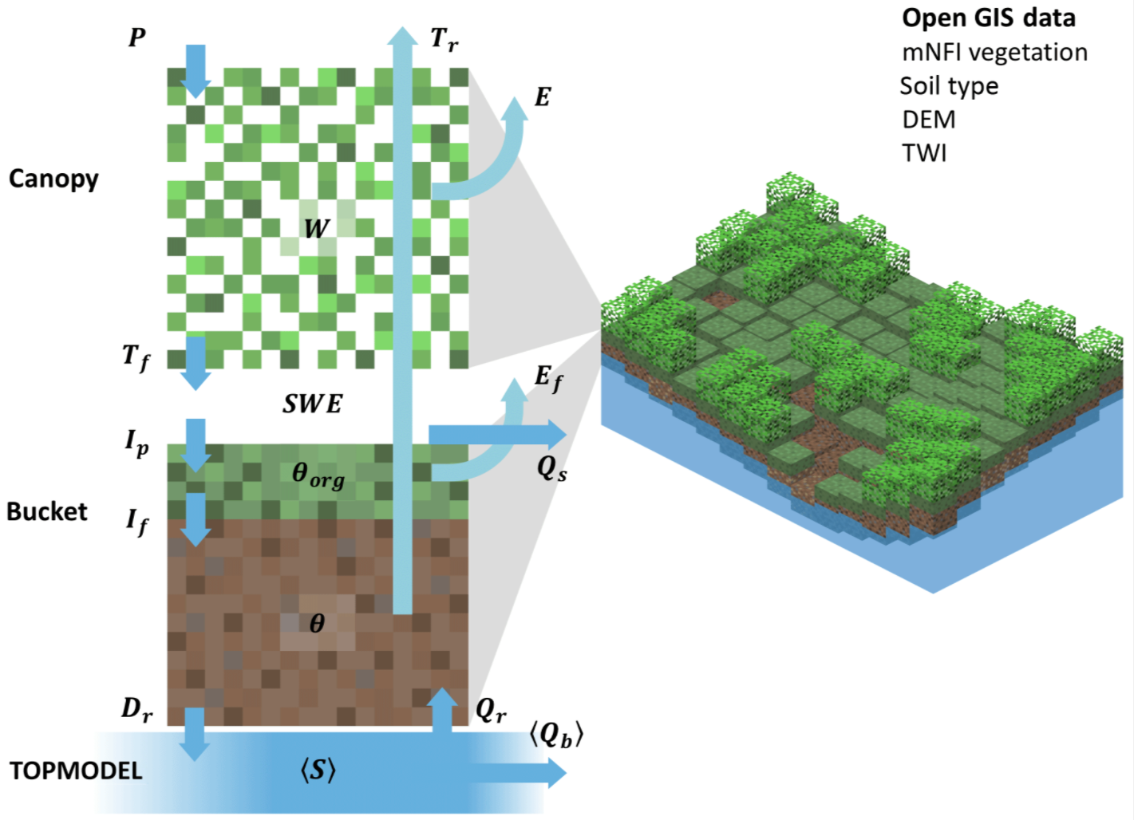

SpaFHy model (Spatial Forest Hydrology)
J-P Nousu
Canopy module
Hydrology in vegetation and snowpack
Bucket module
Organic moss-humus layer
Rootzone layer
Groundwater modules
1D: Free drainage from Bucket module
TOP: TOPMODEL approach
Return flow from cells with high topography wetness indices
2D: Lateral groundwater flow model
Explicit representation of groundwater dynamics
Modified from Launiainen et al. 2019
1D (NO GW )
TOP (TOPMODEL)
2D (GW FLOW)
Written in Python
object-oriented programming

Slide 24
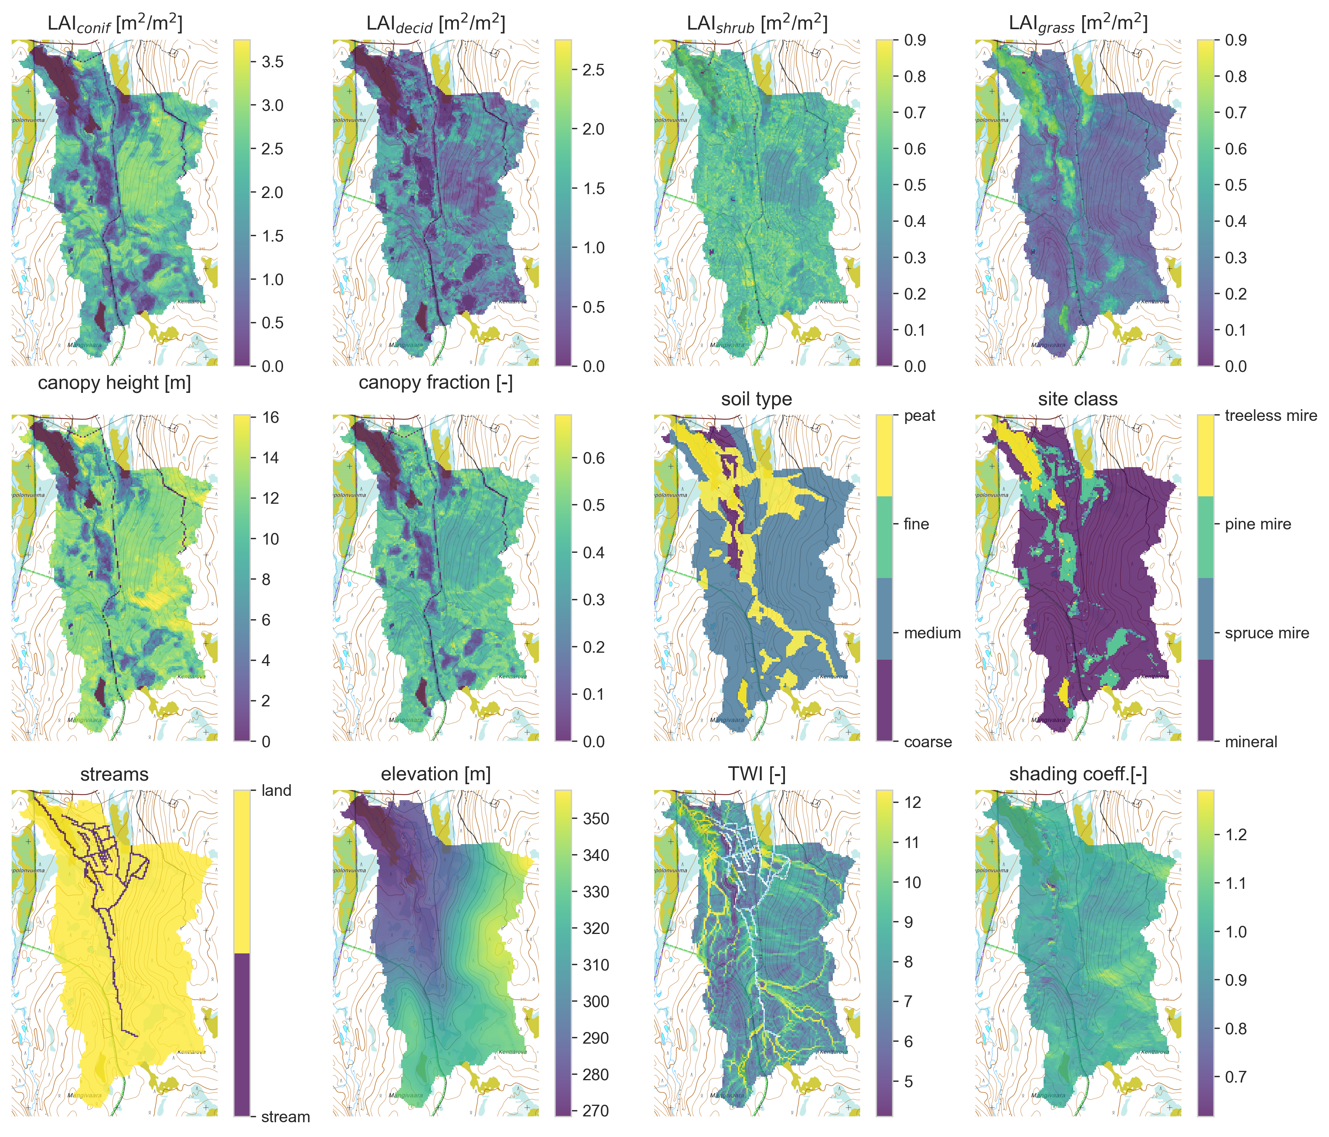



SpaFHy inputs
16 m spatial resolution
Canopy module
LAI (coniferous, deciduous, shrub, grass)
Canopy height and fraction
Shading coefficient
Bucket module
Site class (organic moss-humus layer)
Soil type (rootzone layer)
Groundwater modules (TOP, 2D)
Soil type, elevation, TWI, streams
+ Daily meteorological forcing
Input raster as ASCII
Outputs as NetCDF

Slide 25
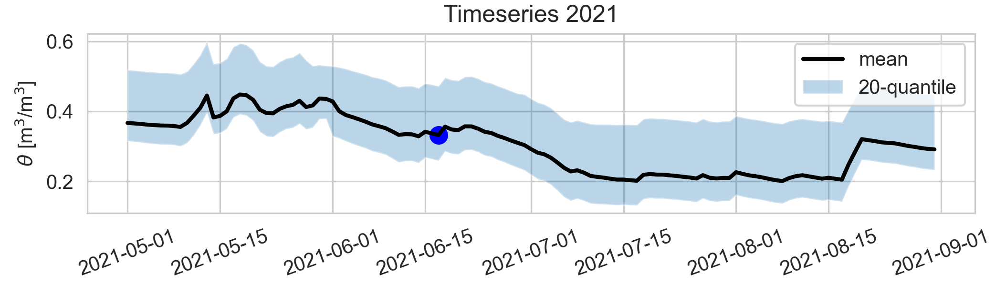
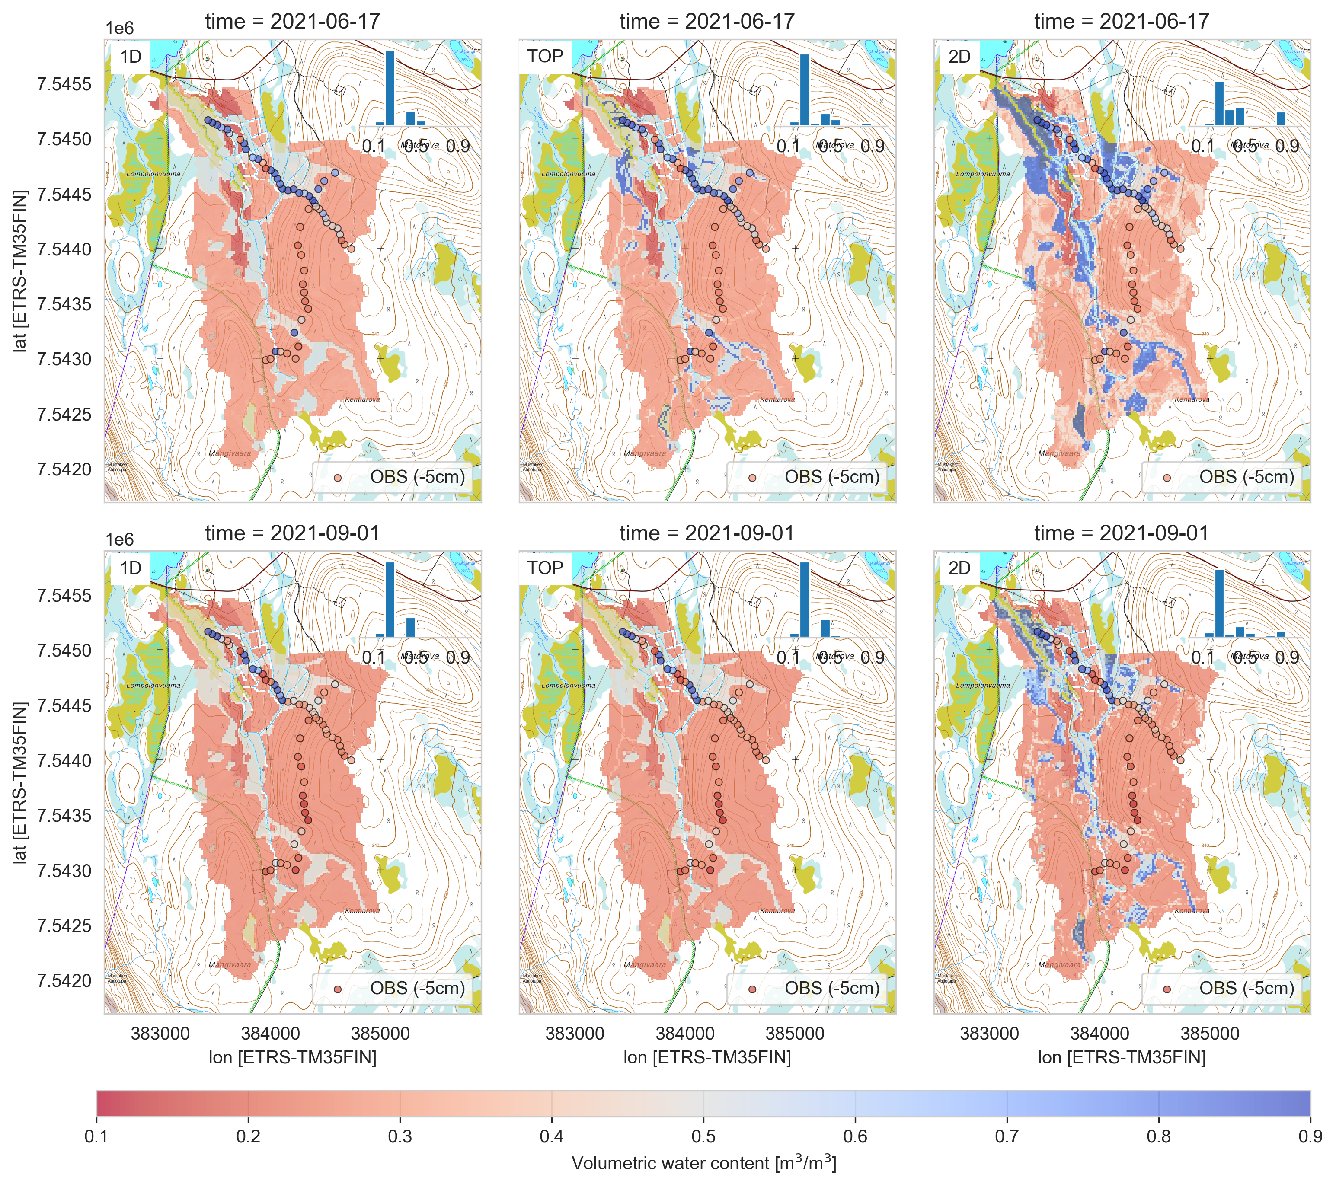
Spatial comparison of model versions (wet day)
+ cells with high
wetness index
+ groundwater-fed
areas
3 soil types
Notes:
Comparing the model versions with in-situ measurements
Wet day in 2021 still highly impacted by the snow melt
2D model superior to other versions
Point measurements only represent fraction of the area

Slide 26
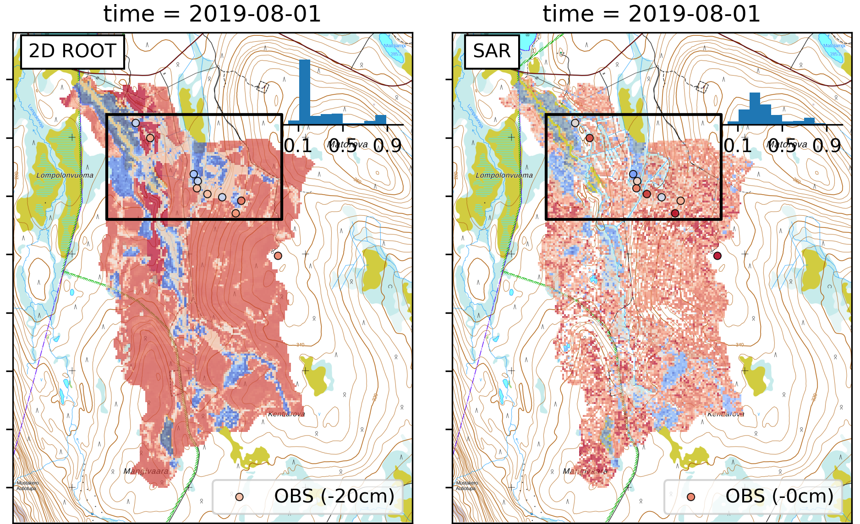

Spatial comparison to SAR-estimates (dry day)
Main patterns are matching
SAR contains high cell-to-cell variability (noise)
Nousu et al. (2024): Multi-scale soil moisture data and process-based modeling reveal the importance of lateral groundwater flow in a subarctic catchment (in prep.)
Notes:
SAR is another spatially explicit data

Slide 27




Water limitations – where most likely?
Paunulanpuro –catchment (ca. 150 ha), Orivesi, Southern Finland
Simulated daily soil moisture for 2000 – 2015 period
Increasing
water limitations→
BA & Vol
Stand density effects modulated by soil water
holding capacity, topographic position and species composition
From mNFI
Launiainen et al. 2022, https://doi.org/10.3390/f13111797

Slide 28

Ecosystem ecology with process-based models
Tracking isotopic signals in trees using mechanistic modeling – unraveling the climatic response of boreal forests imprinted in decadal tree ring archives (Kersti Leppä 2021-2025, post-doc)
A novel intra-molecular isotopic approach to infer past climate and plant responses from tree-ring archives (MoleO 2021-2025, Katja Rinne-Garmston)
From forest structure to hydrological function – merging dense Earth Observation data and process-models (LS-HYDRO, 2023-2027)
Precision nutrient management - a tool for mitigation of climate change and environmental loading in boreal forestry (PREFER, 2022-2026)
DRONESTRESS – Multi-scale assessment of vegetation resilience to drought and pathogens: reconciling drone remote sensing, eddy-covariance, sap flow sensors and satellite data (2022-25, Pavel Alekseychik, post-doc)
pyAPES: vertically resolved view to soil-vegetation-atmosphere interface
→ ¹³C & ¹⁸O isotopes; stem water transport, snow energy balance
SpaFHy-C: distributed ecohydrology
high-resolution carbon budgets, merging with EO-data
3D ray-tracing radiation model
NutSpaFHy: distributed nutrient balance & leaching
→ Stand growth, fertilization effects
Peatland Simulator Susi: holistic peatland forest management
Collaborating with Annamari Laurén (UH, peatland forestry)
Modular, open Python code
See: https://github.com/LukeEcomod

